Slide 1
Total Internal Reflection

Slide 2
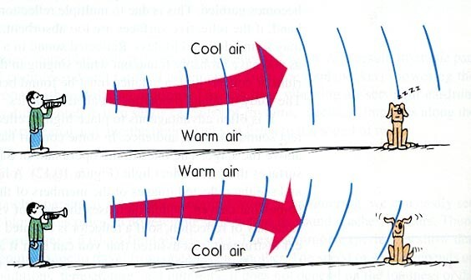
Refraction of Sound

Slide 3
Refraction of Light
A pond or swimming pool may appear shallower than they actually are, a pencil in a glass of water will appear bent
All of these effects are caused by changes in the speed of light as it passes from one medium to another, or through varying temperatures and densities of the same medium – which changes the directions of light rays
Index of Refraction (n) = (speed of light in vacuum)/(speed of light in material)
Snell’s Law: n sin θ = n´ sin θ´ (where n and n´ are the indices of refraction of the media on either side of the boundary, and θ and θ´ are the respective angles of incidence and refraction)

Slide 4
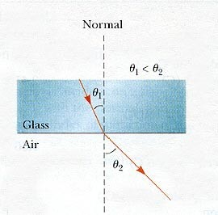
Refraction of Light

Slide 5
Atmospheric Refraction
On hot days there may be a layer of very hot air in contact with the ground, the light will travel faster through this air and will bend, creating a mirage
When you watch the sun set, you can still see the sun for several minutes after it has sunk below the horizon, because light is refracted by Earth’s atmosphere

Slide 6
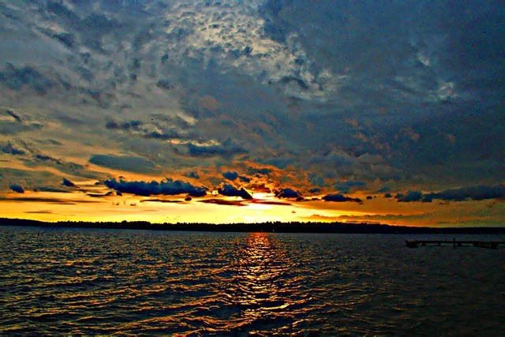
Atmospheric Refraction

Slide 7
Dispersion in a Prism
Light of frequencies closer to the natural frequency of the electron oscillators in a medium travels more slowly in the medium
Since different frequencies of light travel at different speeds in transparent materials, they will refract differently and bend at different angles
When light is bent twice at nonparallel boundaries, as in a prism, the seperation of the different colors is apparent
Dispersion – the separation of light into colors arranged according to their frequency

Slide 8
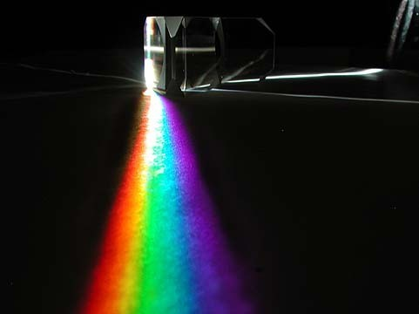
Dispersion in a Prism

Slide 9
The Rainbow
The rainbow takes the concept of dispersion and multiples it through the atmosphere
The sun shines on water droplets in a cloud or when it is raining
The light is dispersed by the raindrop into its spectral colors

Slide 10
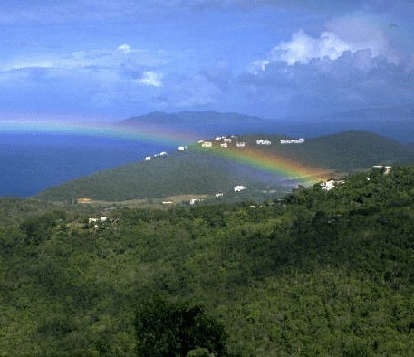
The Rainbow

Slide 11
Total Internal Reflection
Critical Angle – the minimum angle of incidence for which a light ray is totally reflected within a medium
Total Internal Reflection – the 100% reflection of light that strikes the boundary between two media at an angle greater than the critical angle
Optical fibers utilize the concept of total internal reflection to feed light from one location to another, these cables are very useful for communications

Slide 12
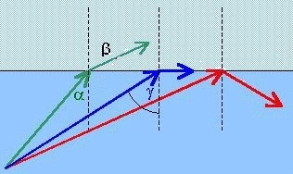
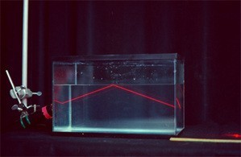
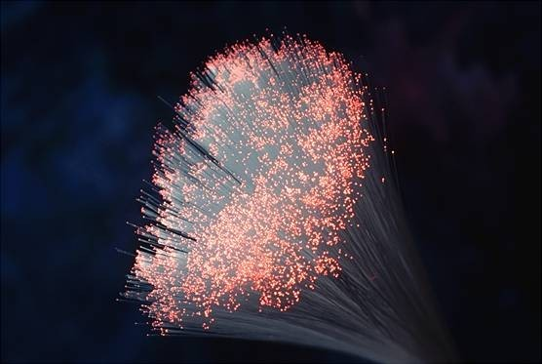
Total Internal Reflection

